Slide 1
ISIS Twitter Analysis
Who is the mastermind?

Slide 2
Followers = Importance ?

Slide 3
Data Description
17,410 tweets from 107 pro-ISIS twitter accounts since 2015 Paris attack.
Basic information of each tweet and its author.

Slide 4
Data Processing
Tokenization
Getting rid of common words and non-word tokens
For each token, find out who used it first, and who used it afterwards

Slide 5
Results
To make the graph less messy, we only picked tokens that were used more than 100 times.

Slide 6
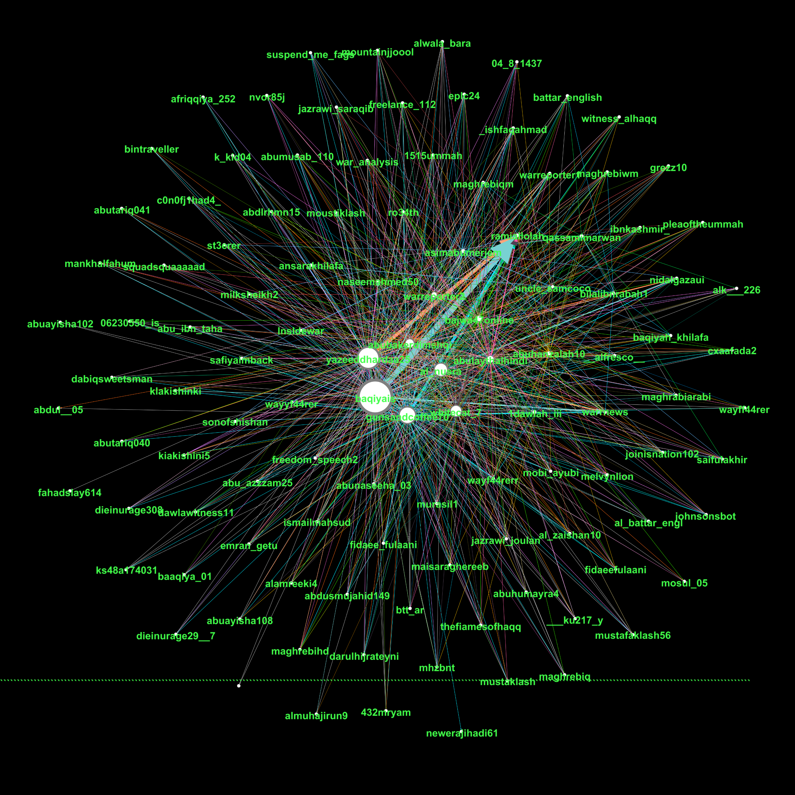
Follower count: baqiyais: 25 yazeeddhardaa25: 823 gunsandcoffee70: 623 al_nusra: 313 ramiallolah: 34692 Out-degrees do not significantly correlate with follower counts.

Slide 7
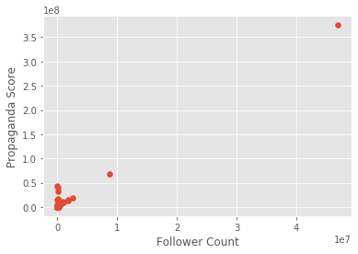
Propaganda score = 1 * 1st time use + 0.5 * 2nd time use
Please notice that the graph does not show a linear relation between propaganda score and follower count, which means accounts with more followers are not necessarily more important

Slide 8
Practicality of this Project
Find out who is making up new ideas for those ISIS accounts.
Word bag monitoring: Preemptive measures.

